Slide 1
Statistics
Saravana

Slide 2
Terminologies In Statistics
One should be aware of a few key statistical terminologies while dealing with Statistics for Data Science. I’ve discussed these terminologies below:
Population is the set of sources from which data has to be collected.
A Sample is a subset of the Population
A Variable is any characteristics, number, or quantity that can be measured or counted. A variable may also be called a data item.
Also known as a statistical model, A statistical Parameter or population parameter is a quantity that indexes a family of probability distributions. For example, the mean, median, etc of a population.

Slide 3
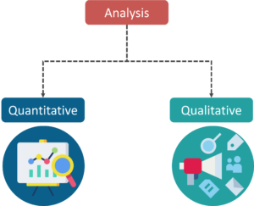
Types Of Analysis An analysis of any event can be done in one of two ways
Quantitative Analysis: Quantitative Analysis or the Statistical Analysis is the science of collecting and interpreting data with numbers and graphs to identify patterns and trends.
Qualitative Analysis: Qualitative or Non-Statistical Analysis gives generic information and uses text, sound and other forms of media to do so.

Slide 4
Categories In Statistics
There are two main categories in Statistics, namely:
Descriptive Statistics
Inferential Statistics

Slide 5
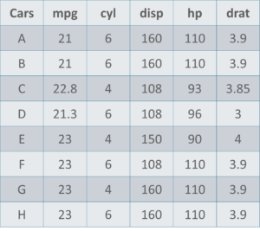
Understanding Descriptive Analysis
When we try to represent data in the form of graphs, like histograms, line plots, etc. the data is represented based on some kind of central tendency. Central tendency measures like, mean, median, or measures of the spread, etc are used for statistical analysis.
Measures Of The Center
Mean: Measure of average of all the values in a sample is called Mean.
Median: Measure of the central value of the sample set is called Median.
Mode: The value most recurrent in the sample set is known as Mode

Slide 6
Measures Of The Spread
Just like the measure of center, we also have measures of the spread, which comprises of the following measures:
Range: It is the given measure of how spread apart the values in a data set are.
Inter Quartile Range (IQR): It is the measure of variability, based on dividing a data set into quartiles.
Variance: It describes how much a random variable differs from its expected value. It entails computing squares of deviations.
Deviation is the difference between each element from the mean.
Population Variance is the average of squared deviations
Sample Variance is the average of squared differences from the mean
Standard Deviation: It is the measure of the dispersion of a set of data from its mean.

Slide 7
Understanding Inferential Analysis
Statisticians use hypothesis testing to formally check whether the hypothesis is accepted or rejected. Hypothesis testing is an Inferential Statistical technique used to determine whether there is enough evidence in a data sample to infer that a certain condition holds true for an entire population.
For example, to measure the diameter of each nail that is manufactured in a mill is impractical. You can measure the diameters of a representative random sample of nails. You can use the information from the sample to make generalizations about the diameters of all of the nails.

Slide 8
Probability Distributions
We can define probability as the percent chance that some event will occur. In data science this is commonly quantified in the range of 0 to 1 where 0 means we are certain this will not occur and 1 means we are certain it will occur
A Uniform Distribution is the most basic of the 3 we show here. It has a single value which only occurs in a certain range while anything outside that range is just 0. It’s very much an “on or off” distribution. We can also think of it as an indication of a categorical variable with 2 categories: 0 or the value. Your categorical variable might have multiple values other than 0 but we can still visualize it in the same was as a piecewise function of multiple uniform distributions.
A Normal Distribution, commonly referred to as a Gaussian Distribution, is specifically defined by its mean and standard deviation. The mean value shifts the distribution spatially and the standard deviation controls the spread. The import distinction from other distributions (e.g poisson) is that the standard deviation is the same in all directions. Thus with a Gaussian distribution we know the average value of our dataset as well as the spread of the data i.e is it spread over a wide range or is it highly concentrated around a few values.
A Poisson Distribution is similar to the Normal but with an added factor of skewness. With a low value for the skewness a poisson distribution will have relatively uniform spread in all directions just like the Normal. But when the skewness value is high in magnitude then the spread of our data will be different in different directions; in one direction it will be very spread and in the other it will be highly concentrated.

Slide 9
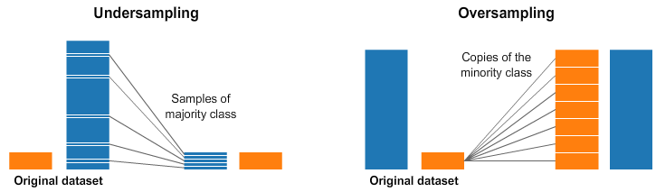
Over and Under Sampling

